Slide 1
National College of Arts
Resuming Academic Activity & Implementation of SOPs In Consideration of COVID-19
(September, 2020 to date)

Slide 2
Academic Plan
All faculty members (Permanent & Contractual), NCA, Lahore & Rawalpindi Campus are notified to remain on duty from 15th September 2020.
Regular (face to face) classes for thesis year students of Graduate and Undergraduate commenced from 21st September and classes for rest of the years commenced online simultaneously from 21st September 2020. The duration of the online classes has been kept the same as during regular classes.
Since the NCA draws its student body from all over Pakistan and given this fact there is large number of resident students who will have to be accommodated in the hostels and in consideration of the SOPs for Covid-19, only a limited number of students could be accommodated in hostels and studios. Therefore, only Thesis years are called in to attend regular classes.
Formats for Teaching plans, student attendance, and assessment have been shared with the faculty members for online classes.

Slide 3
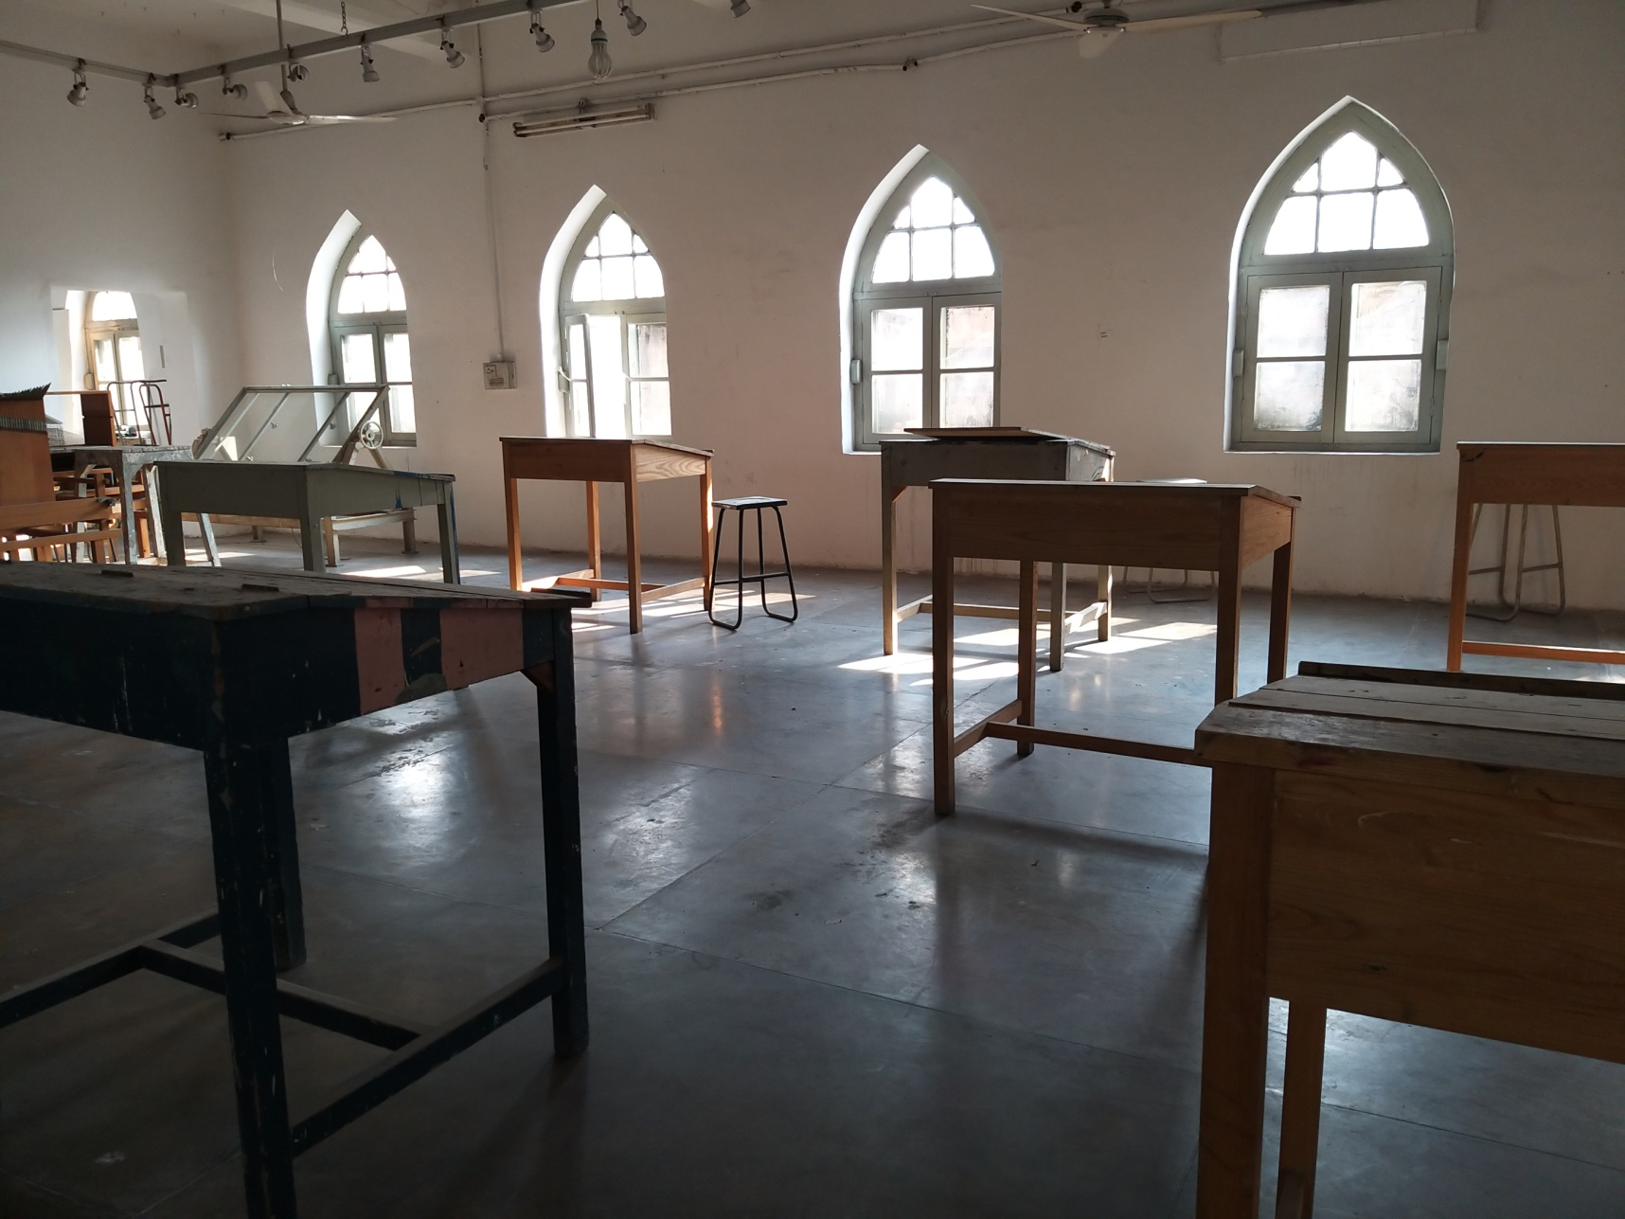
Studio Space Distance for Thesis Students

Slide 4
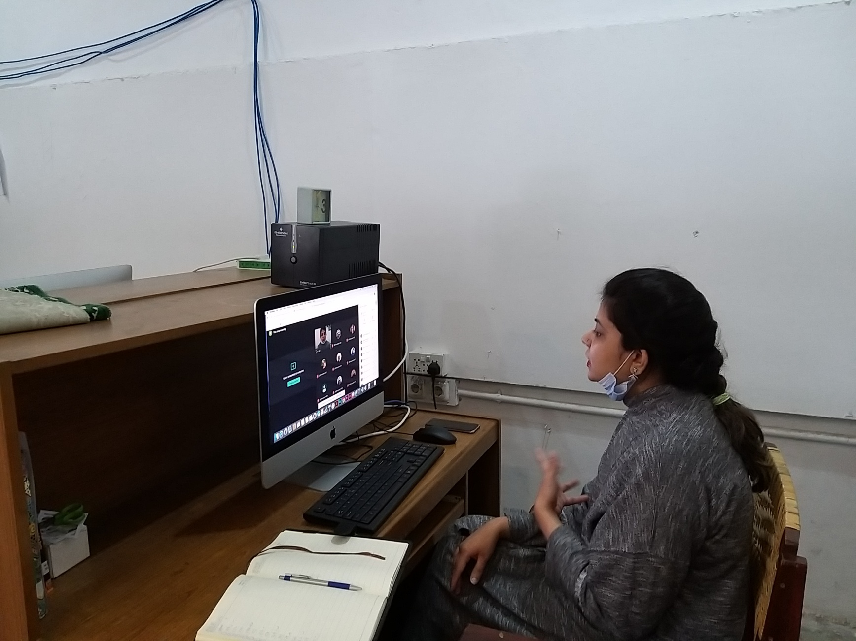
Teachers conducting online classes

Slide 5
General SOPs on campus and Cafeteria in Consideration of COVID-19
In connection with COVID-19 a series of workshops have been held by our Chief Medical Officer, to aware the employees and for proper implementation of SOPs.
2. Face recognition system has been installed on the entrance/exit and number of entry/exit points have been increased to ensure social distancing.
3. Awareness posters have been displayed on Notice Boards, entrances, offices and studios , washrooms, cafeteria, and library.
4. Non-contact temperature assessment devices (Thermometer guns) are provided at the gates to check the temperature of whoever enters the premises.
5. Entry is not allowed to persons not wearing masks.
6. Hand sanitizers placed on various spots of campus from main gate entrance to office, library, gallery, classroom, studio, cafeteria and exit.
7. Cafeteria Committee issued protocols to ensure SOPs

Slide 6
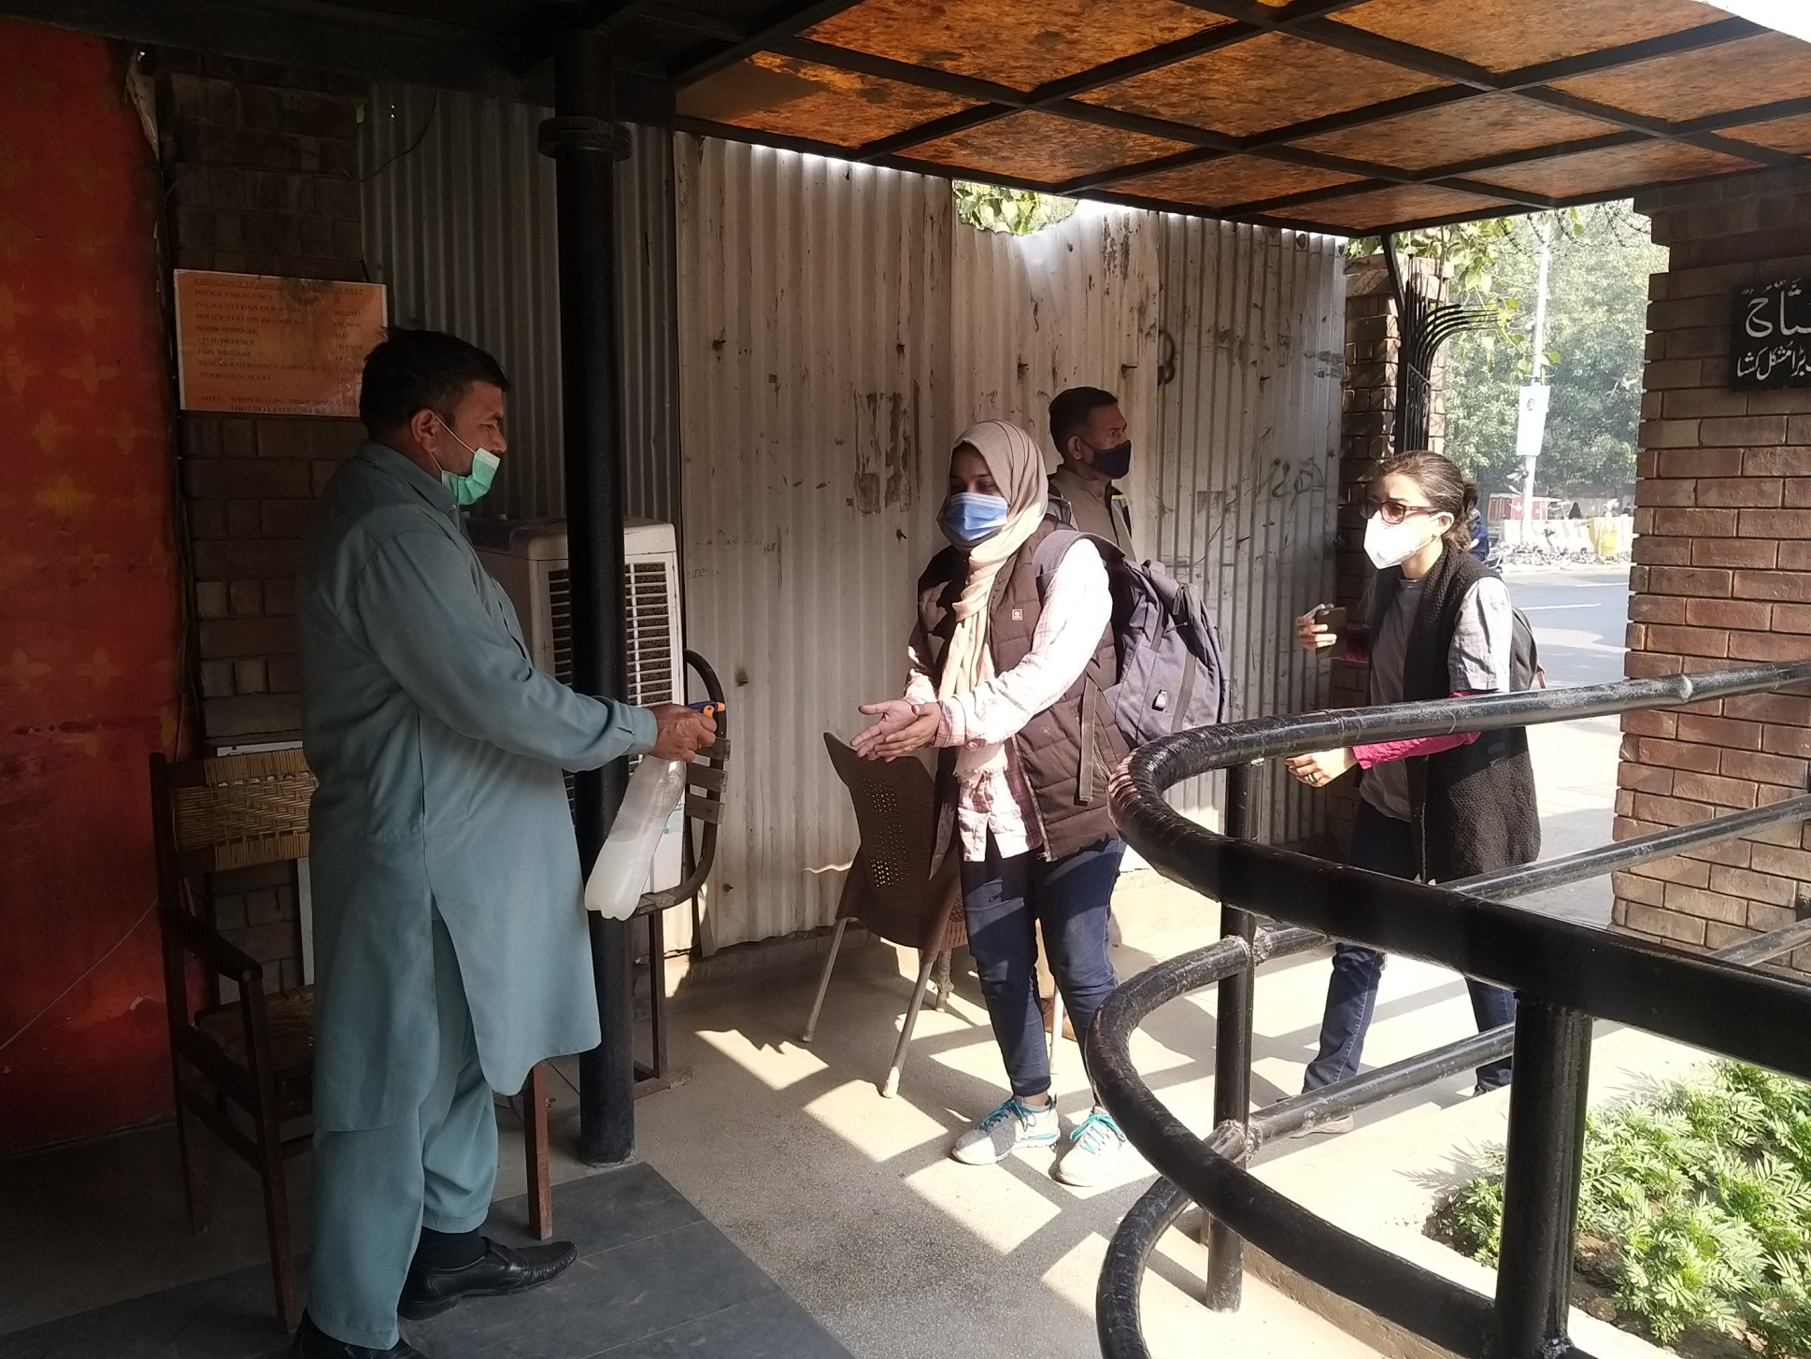

Slide 7
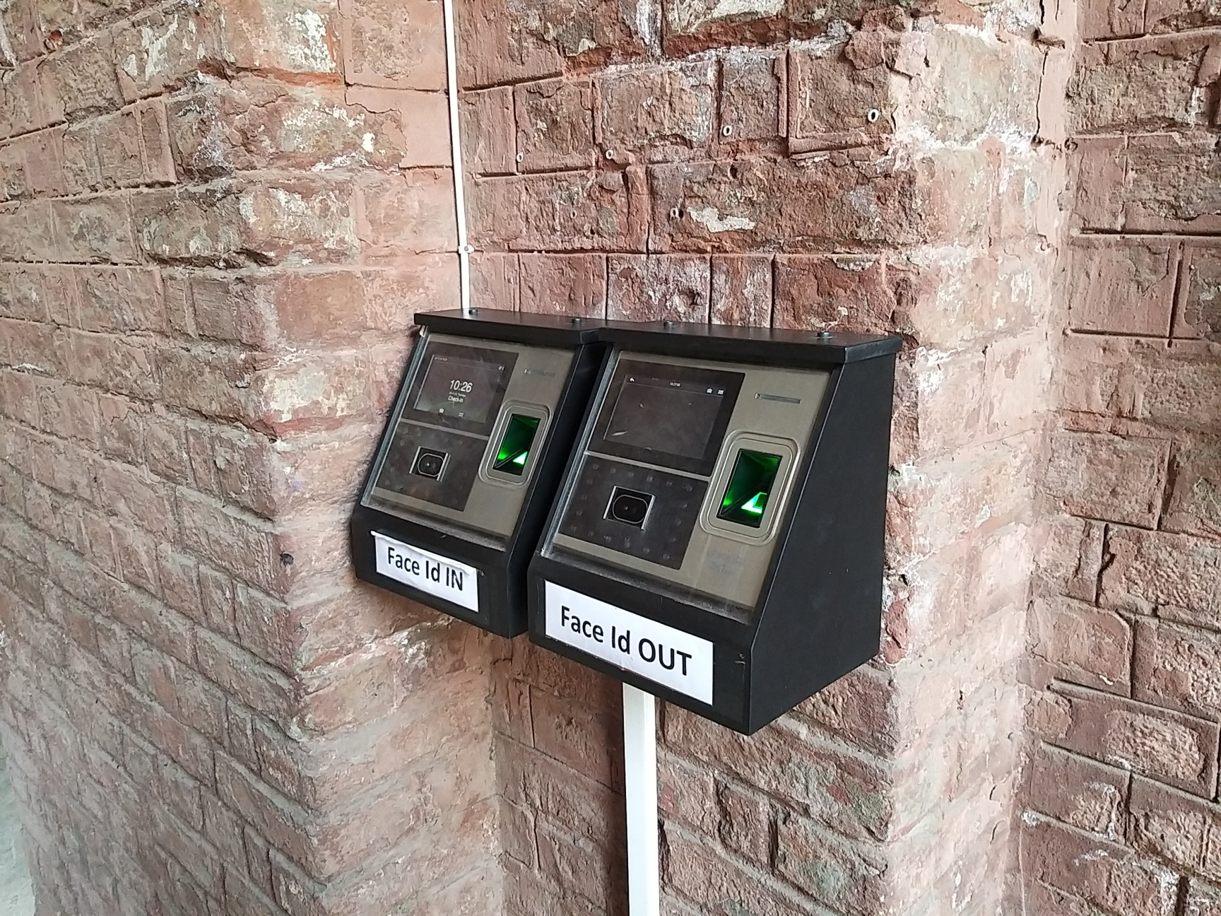
Face Recognition Biometric Device

Slide 8
8. The cafeteria staff submitted negative test reports before the café was opened.
9. Number of counters for food and payment have been increased to divide the gathering at one counter.
10. Students and offices have been given the option to order food via telephone extension number and a whatsapp group.
11. Cafeteria staff is required to wear face mask and gloves and wash their hands at regular intervals.
12. Food is delivered in disposable packaging
13. Number of washbasins is being increased for better facilitation for students and staff.
14. The College premises and furniture is disinfected every day before it is opened.

Slide 9
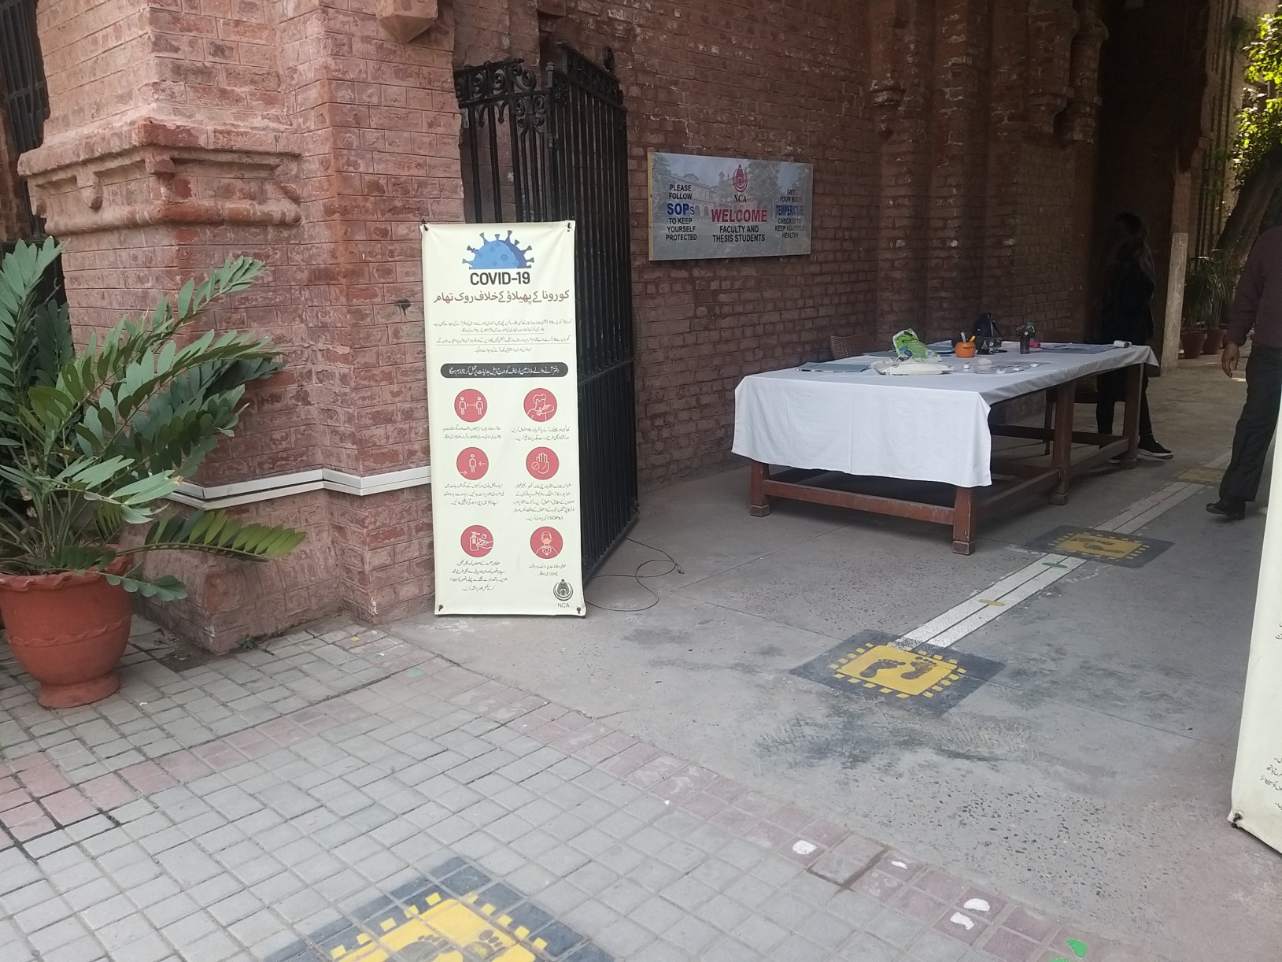
Awareness Posters and Flex

Slide 10
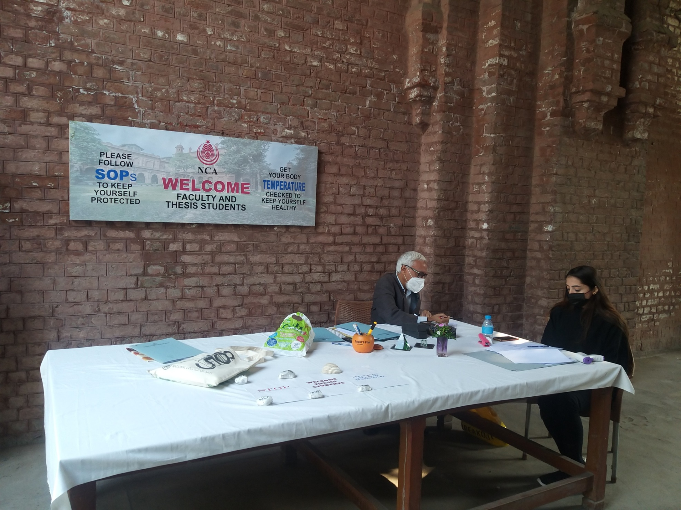
Temperature Recording Desk

Slide 11
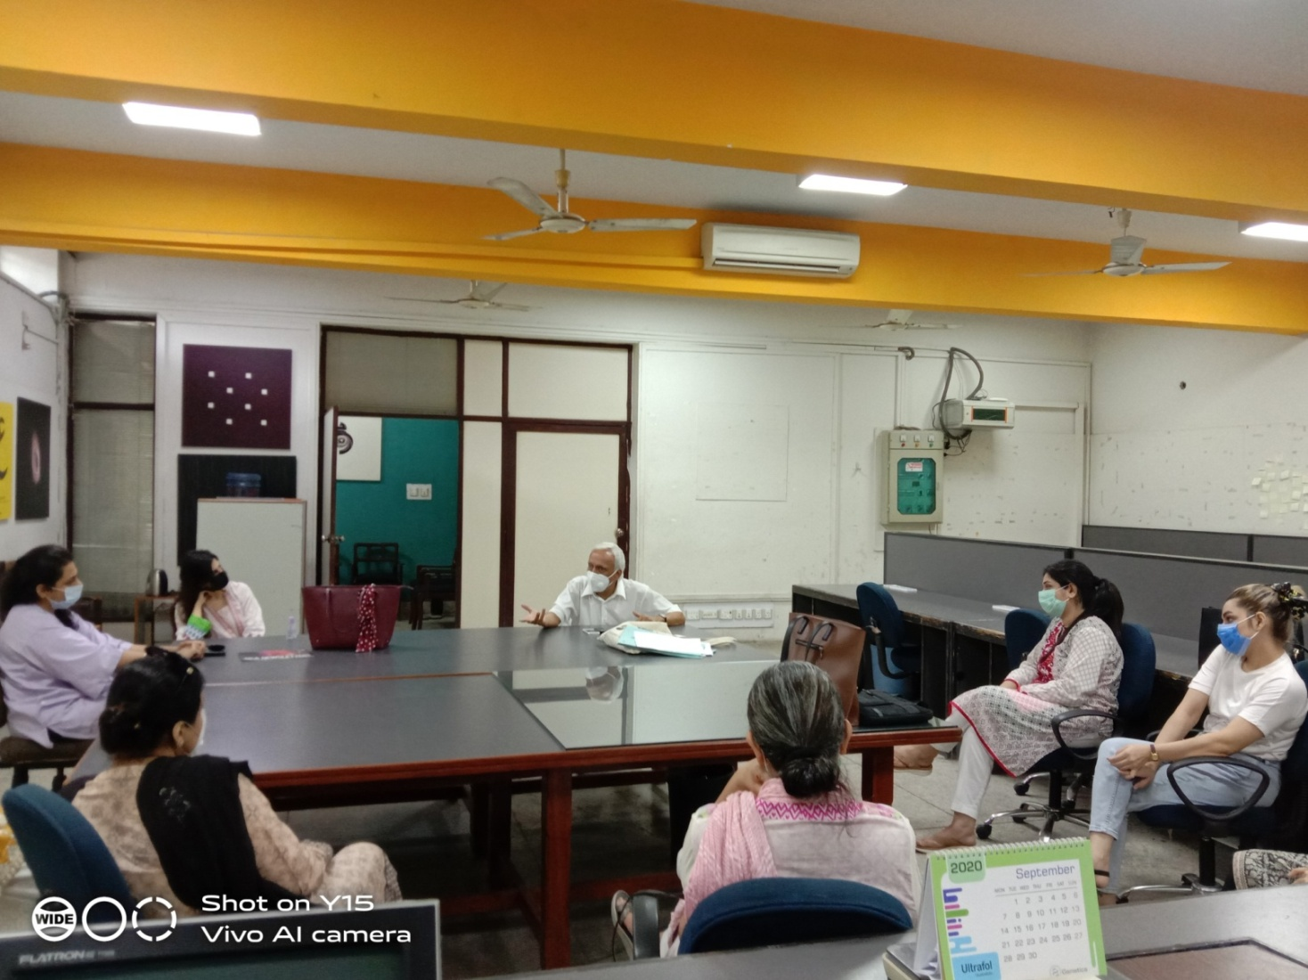
In connection with COVID-19 a series of workshops conducted by Chief Medical Officer, to aware the students for proper implementation of SOPs.

Slide 12
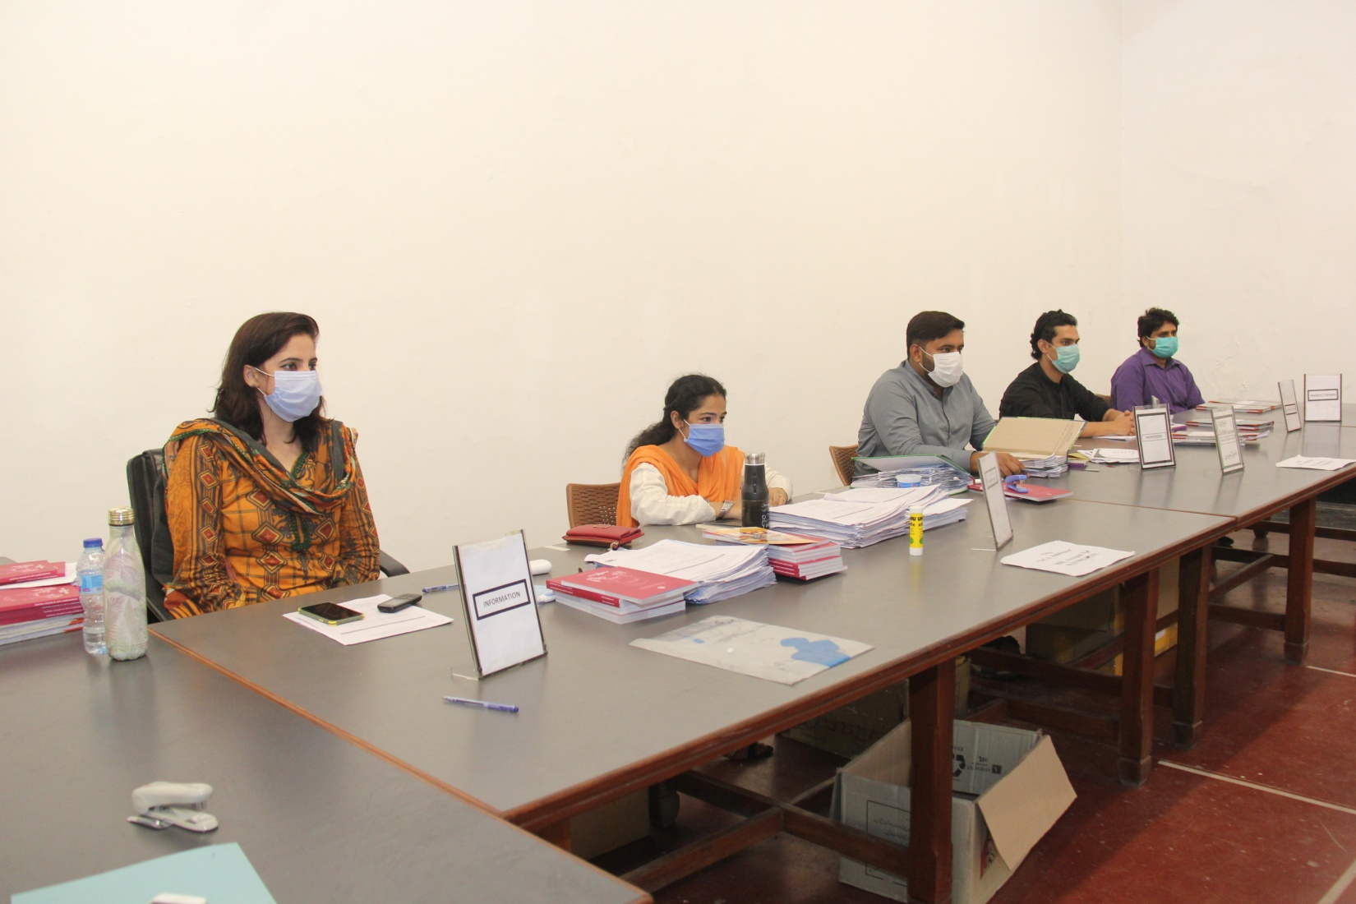
Admission Secretariat Followed SOPs During the time of COVID-19 from 31^{stAugust} to 30^{th September,2020}

Slide 13
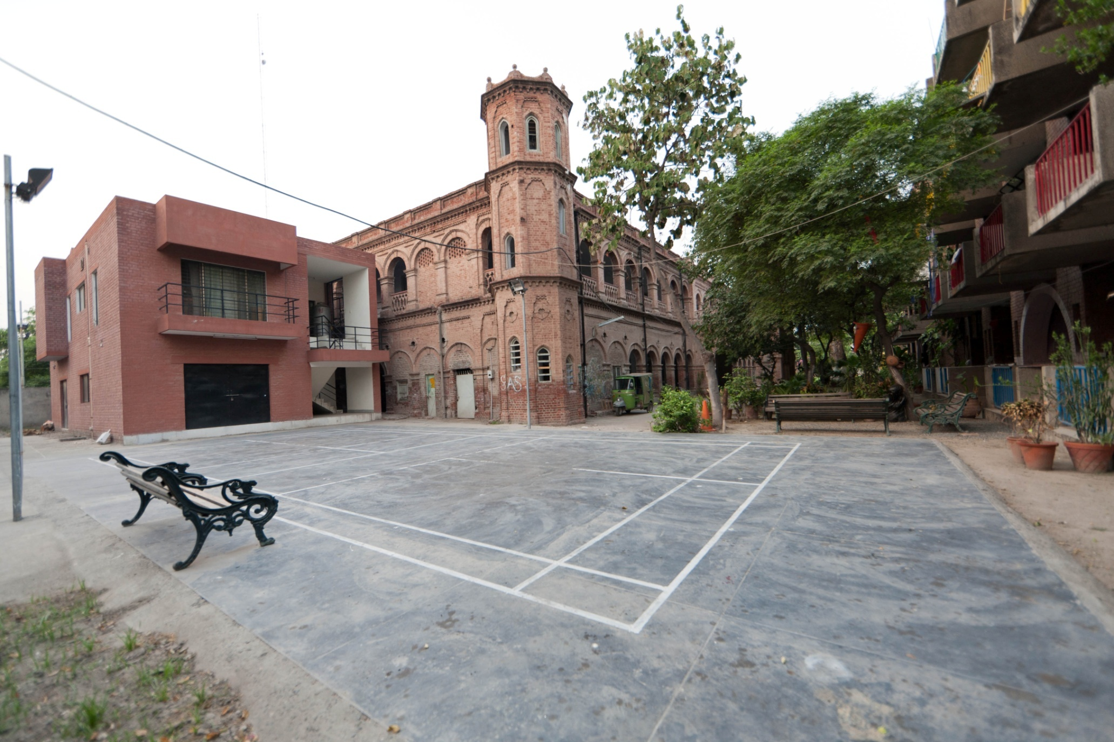
NCA Hostel

Slide 14
Re-opening of NCA Hostel (Boys & Girls) Accommodation for Thesis Students.
1. Accommodation for thesis students has been re-allocated on single occupancy basis during covid-19 period.
2. No room has been opened without a prior adaptation of safety measures.
3. Luggage and belongings of students has been also disinfected.
4. Temperature of the students has been checked at the entrance.
5. The students has not been allowed to invite guests, friends or visitors to stay at the hostel.
6. The hostel kitchen has been started a delivery service to the rooms in order to avoid gatherings in dining area and TV room.
7. Wearing of the mask is mandatory while leaving room and while in open space.
8. Walking and seating in groups in open spaces has been restricted.
9. Disinfecting the premises on a daily basis has been ensured.
10. Soaps and hand sanitizers has been made available at all places likely to cause any physical interaction.
11. Awareness posters has been displayed at all important points.
12. Strict action has been taken against any violation of the SOPs.

Slide 15
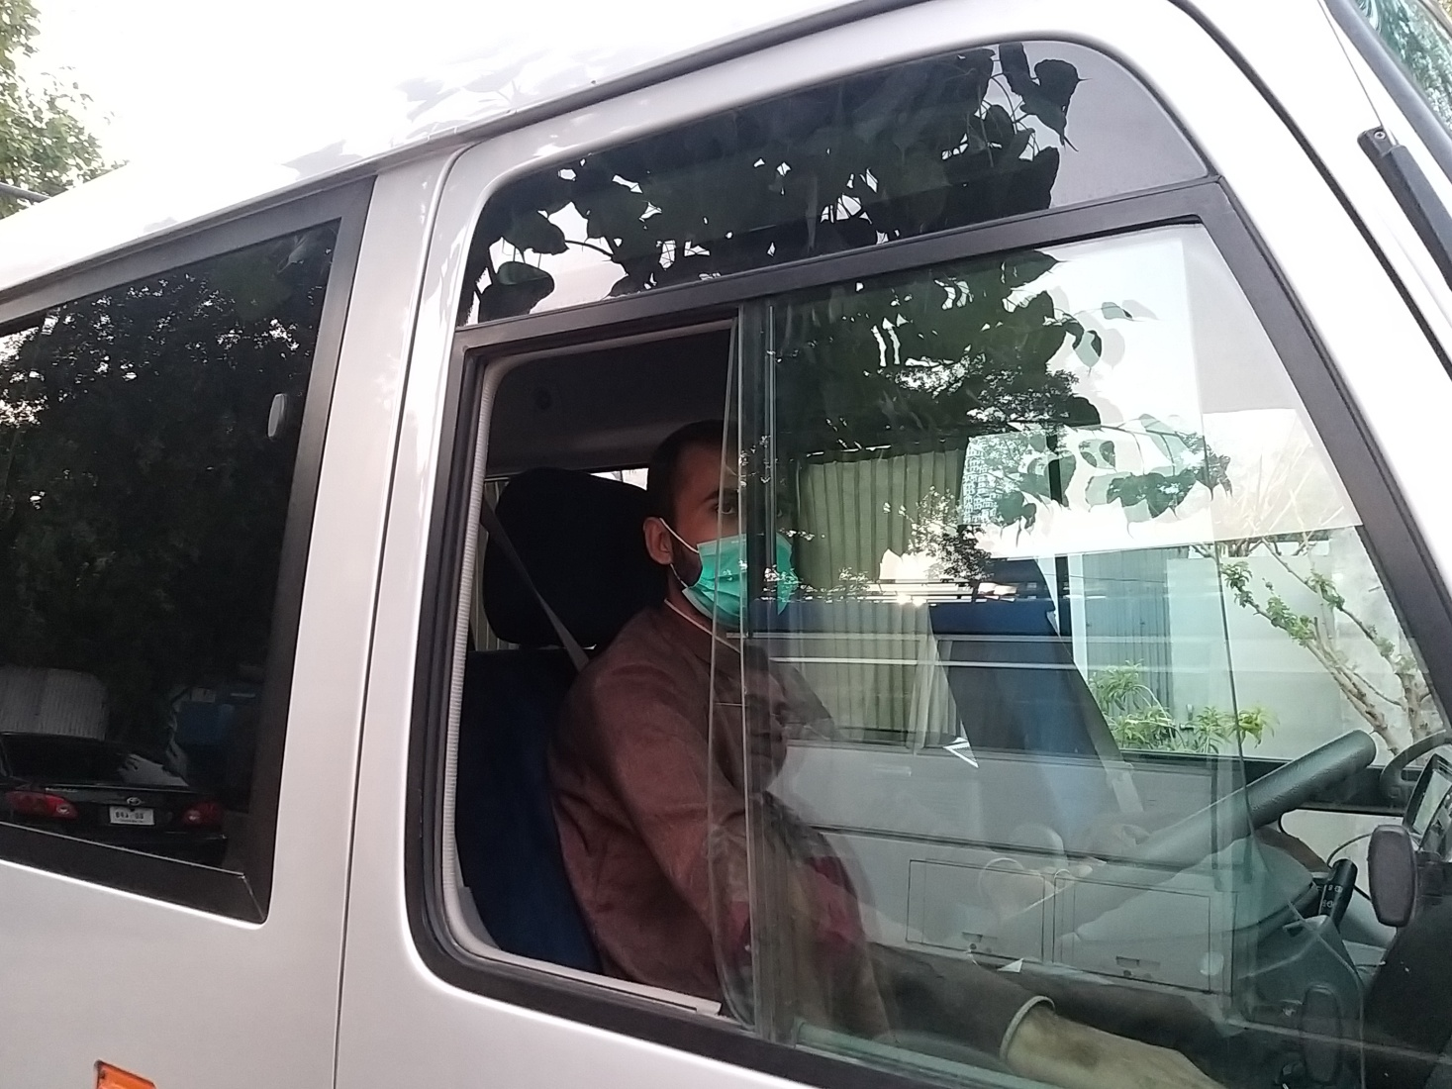

Slide 16
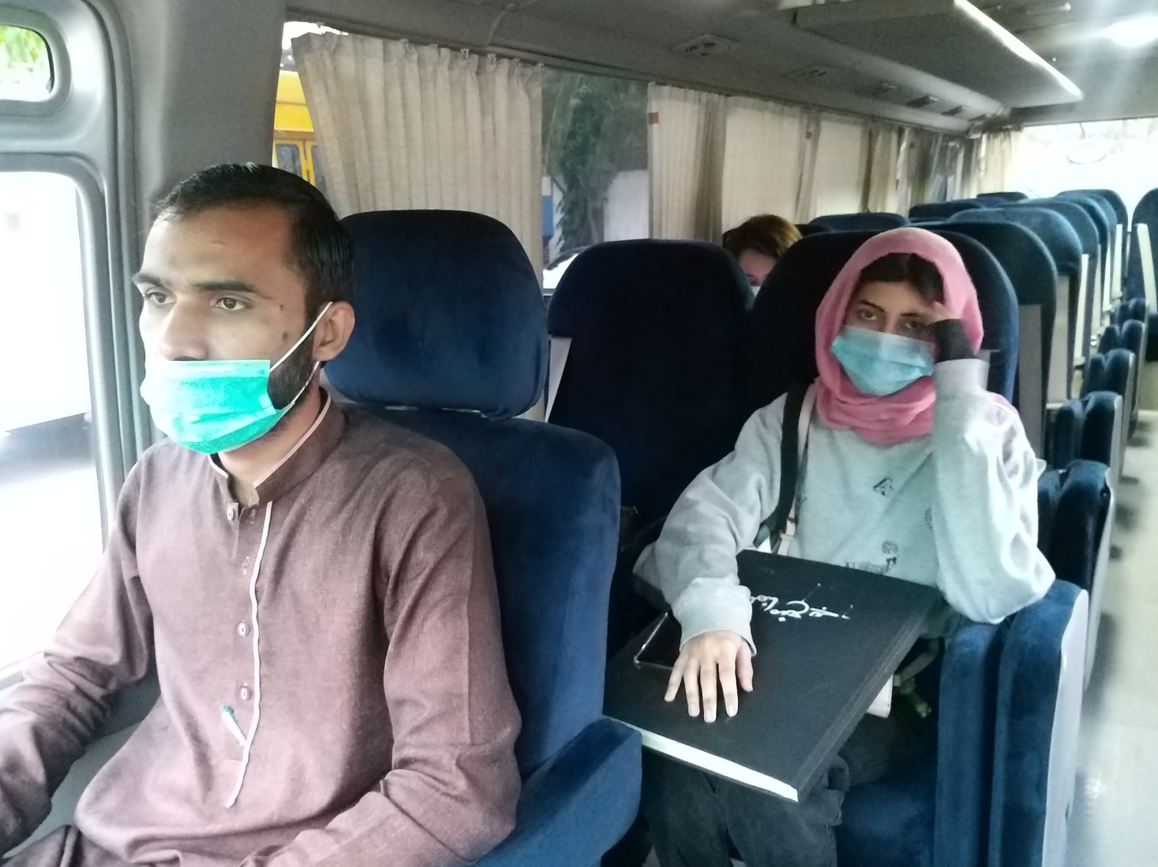

Slide 17
Transport Routine during COVID-19
1. Transport routine preventing measures are advised during pick and drop facility provision for thesis year students from 21st September 2020.
2. Seats of vehicles are disinfected before and after the routes.
3. Only 28 students are allowed to travel in the bus with a passenger capacity of 60 seats
4. No one is allowed to travel without face mask.

Slide 18
PCR Tests Conducted by Primary & Secondary HealthCare Department by Punjab
Random tests were Conducted on 23rd and 24th,October 2020
53 samples were taken at National College of Arts and all resulted negative.
One teacher of Foundation Year was found Covid-19 positive but since she was on leave at very early stages of the symptoms, the virus did not spread but the faculty members and associated staff were sent in quarantine for two weeks.

Slide 19
Thank you

